Slide 1
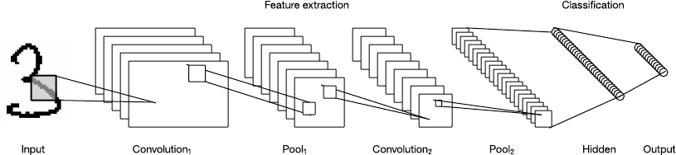
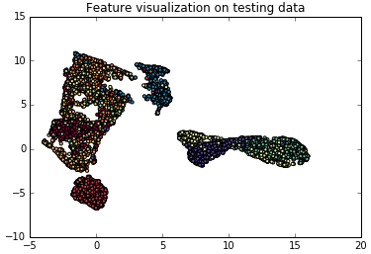
MATH 6380J Mini-Project 1: Feature Extraction and Transfer Learning
Zengqiang Yan and Pei Wang {z.yan, pwangai}@connect.ust.hk
Department of Computer Science and Engineering, HKUST
1. Introduction
3. Scattering Nets
5. Analysis
We have conducted experiments on feature extraction and transfer learning based on pre-trained deep learning models and scattering nets. The main goal of this project is to evaluate the performance of different networks for feature extraction and to compare different fine-tuning strategies.
The scattering net is able to extract features that are translation invariant and more stable in terms of high frequency items. We have tested the performance and visualization of scattering net tighter with a few layers of convolution kernel (upper) and LDA (lower) as well.
From our results and visualization of features, we can observe that the hybrid scattering net and CNN outperforms others. We believe that the scattering net generates better feature for further supervised classification like CNN layers.
In terms of using LeNet for feature extraction and transfer learning, applying the fine-tuning strategy is better than directly extracting features from the pre-trained model. Finetuning all layers (first few layers with lower learning rate) is better than finetuning the last layer alone, which demonstrates that even those low-level features are slightly different among datasets.
2. Fashion-MNIST Dataset
The Fashion-MNIST dataset contains 60,000 training images and 10,000 testing images with the same resolution as 28⨯28. Compared to the MNIST dataset, the Fashion-MNIST dataset is more challenging which is better for quality evaluation.
6. Conclusion
Similar to Fourier Transform, the scattering nets that learns the combination of existing filters could extract more representation features. The translation invariant and more stable in deformation helps the supervised classification.
Classification on different datasets can share common features, which can be extracted by pre-trained deep learning models. The common features usually are low-level features (first several layers), so that only fine-tuning the last layers can effectively improve the performance.
Training a new model from scratch is the upper bound of transfer learning.
4. LeNet
As the resolution of training images is 28⨯28, we can only adopt pre-trained model on the MNIST dataset for feature extraction and transfer learning. From the feature visualization, we find that when using LeNet to extract features of the Fashion-MNIST dataset, the features are not distinguishable enough for accurate classification. By applying transfer learning (e.g. finetune), the overall accuracy is effectively improved.
Architecture
Fashion-MNIST
MNIST
Dataset | Method | Accuracy
Fashion-MNIST | PCA + LDA | 0.7915
 | Scattering Nets + CNN | 0.9830
 | Scattering Nets + LDA | 0.8521
 | LeNet + SVM | 0.8128
 | LeNet + Finetune | 0.8303
 | LeNet + Finetune All | 0.8336
 | LeNet + Re-Train | 0.8447
Manifold learning for visualization
8. Contribution
Scattering Nets part
Pei Wang
LeNet part
Zengqiang Yan

